Slide 1
Single layered Perceptron

Slide 2
Brain Vs. Computer

Slide 3
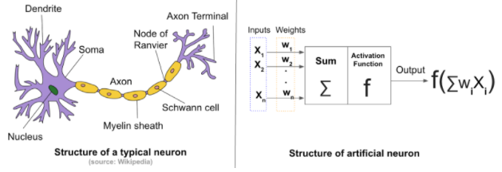
Biological neuron and Artificial neuron

Slide 4
Working of a Biological Neuron
Dendrites − They are tree-like branches, responsible for receiving the information from other neurons it is connected to. In other sense, we can say that they are like the ears of neuron.
Soma − It is the cell body of the neuron and is responsible for processing of information, they have received from dendrites.
Axon − It is just like a cable through which neurons send the information.
Synapses − It is the connection between the axon and other neuron dendrites

Slide 5
Similarities based on the terminology between these biological and artificial neuron
Biological Neural Network (BNN) | Artificial Neural Network (ANN)
Soma | Node
Dendrites | Input
Synapse | Weights or Interconnections
Axon | Output

Slide 6
The comparison between ANN and BNN
Criteria | BNN | ANN
Processing | Massively parallel, slow but superior than ANN | Massively parallel, fast but inferior than BNN
Size | 10¹¹ neurons and 10¹⁵interconnections | 10² to 10⁴ nodes (mainly depends on the type of application and network designer)
Learning | They can tolerate ambiguity | Very precise, structured and formatted data is required to tolerate ambiguity
Fault tolerance | Performance degrades with even partial damage | It is capable of robust performance, hence has the potential to be fault tolerant
Storage capacity | Stores the information in the synapse | Stores the information in continuous memory locations

Slide 7
A Brief History of ANN
ANN during 1940s to 1960s: Some key developments of this era are as follows −
1943 − It has been assumed that the concept of neural network started with the work of physiologist, Warren McCulloch, and mathematician, Walter Pitts, when in 1943 they modeled a simple neural network using electrical circuits in order to describe how neurons in the brain might work.
1949 − Donald Hebb’s book, The Organization of Behavior, put forth the fact that repeated activation of one neuron by another increases its strength each time they are used.
1956 − An associative memory network was introduced by Taylor.
1958 − A learning method for McCulloch and Pitts neuron model named Perceptron was invented by Rosenblatt.
1960 − Bernard Widrow and Marcian Hoff developed models called "ADALINE" and “MADALINE.”

Slide 8
ANN during 1960s to 1980s: Some key developments of this era are as follows −
1961 − Rosenblatt made an unsuccessful attempt but proposed the “backpropagation” scheme for multilayer networks.
1964 − Taylor constructed a winner-take-all circuit with inhibitions among output units.
1969 − Multilayer perceptron (MLP) was invented by Minsky and Papert.
1971 − Kohonen developed Associative memories.
1976 − Stephen Grossberg and Gail Carpenter developed Adaptive resonance theory.

Slide 9
ANN from 1980s till Present
Some key developments of this era are as follows −
1982 − The major development was Hopfield’s Energy approach.
1985 − Boltzmann machine was developed by Ackley, Hinton, and Sejnowski.
1986 − Rumelhart, Hinton, and Williams introduced Generalised Delta Rule.
1988 − Kosko developed Binary Associative Memory (BAM) and also gave the concept of Fuzzy Logic in ANN.

Slide 10
Applications of neural networks
Character Recognition
Image Compression
Stock Market Prediction
Traveling Saleman's Problem
Medicine, Electronic Nose, Security, and Loan Applications

Slide 11
What makes neuronal computation special ?
Electrical activity in neurons
Traveling action potentials
Leaky, conducting membrane
Highly branched structures
A variety of electrical connections between neurons
A varied range of possibilities in neural coding of
information

Slide 12
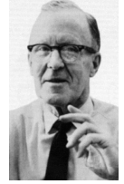
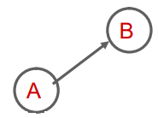
Hebb‘s postulate
When an axon of cell A is near enough to excite a cell B and repeatedly and persistently takes part in firing it, some growth process or metabolic change takes place in one or both cells, such that A s efficiency, as one of the cells firing B, increases.
Repeated simultaneous activation of two cells strengthens the synapses that link them
Long term potentiation : practical demonstration of the Hebbian theory.

Slide 13
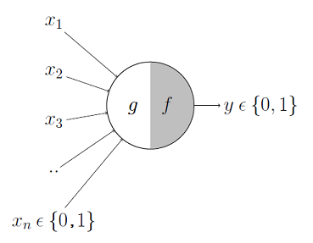
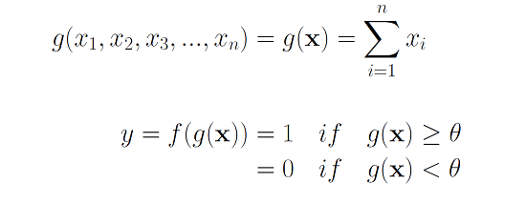
McCulloch-Pitts Neuron
The first computational model of a neuron was proposed by Warren MuCulloch (neuroscientist) and Walter Pitts (logician) in 1943.
The McCulloch-Pitts neural model is also known as linear threshold gate.
It may be divided into 2 parts:
The first part, g takes an input, performs an aggregation and based on the aggregated value the second part, f makes a decision

Slide 14


McCulloch-Pitts Neuron
Their "neurons" operated under the following assumptions:
They are binary devices (Vi = [0,1])
Each neuron has a fixed threshold, theta
The neuron receives inputs from excitatory synapses, all having identical weights. (However it my receive multiple inputs from the same source, so the excitatory weights are effectively positive integers.)
Inhibitory inputs have an absolute veto power over any excitatory inputs.
At each time step the neurons are simultaneously (synchronously) updated by summing the weighted excitatory inputs and setting the output (Vi) to 1 iff the sum is greater than or equal to the threhold AND if the neuron receives no inhibitory input.
We can summarize these rules with the McCullough-Pitts output rule

Slide 15
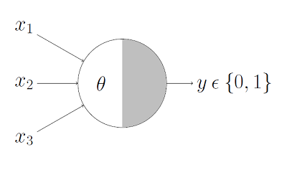
Boolean Functions Using M-P Neuron
This representation just denotes that, for the Boolean inputs x1, x2 and x3 if the g(x) i.e., sum ≥ theta, the neuron will fire otherwise, it won’t.

Slide 16
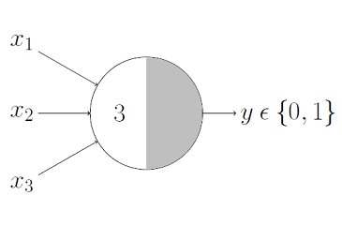

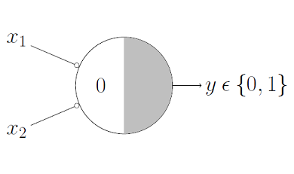
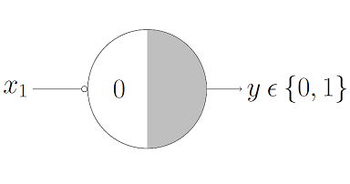
AND Function
OR Function
NOR Function
An AND function neuron would only fire when ALL the inputs are ON i.e., g(x) ≥ 3 here.
This is self explanatory as we know that an OR function neuron would fire if ANY of the inputs is ON i.e., g(x) ≥ 1 here.
For a NOR neuron to fire, we want ALL the inputs to be 0 so the thresholding parameter should also be 0 and we take them all as inhibitory input.
NOT Function
For a NOT neuron, 1 outputs 0 and 0 outputs 1. So we take the input as an inhibitory input and set the thresholding parameter to 0.

Slide 17
Limitations of the McCulloch and Pitts Neuronal Model
What about non-boolean (say, real) inputs?
Real neurons are much more complicated.
The inputs to a real neuron are not necessarily summed linearly
Do we always need to hand code the threshold?
real neurons do not output a single output response, but a spike train
neurons don’t actually respond as threshold devices, but produce a graded output in a continuous way
Are all inputs equal? What if we want to assign more importance to some inputs?
the amount of neurotransmitter (which affects how much charge they required to spike, amongst other things) can vary according to the current state of the organism
The neurons are not updated sequentially according to a computer clock, but update themselves randomly (asynchronously),
What about functions which are not linearly separable? Say XOR function

Slide 18
The Perceptron
The perceptron had the following differences from the McCullough-Pitts neuron:
The weights and thresholds were not all identical.
Weights can be positive or negative.
There is no absolute inhibitory synapse.
Although the neurons were still two-state, the output function f(u) goes from [-1,1], not [0,1]. (This is no big deal, as a suitable change in the threshold lets you transform from one convention to the other.)
Most importantly, there was a learning rule.

Slide 19
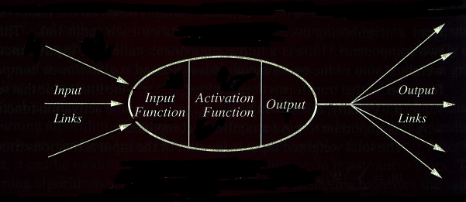
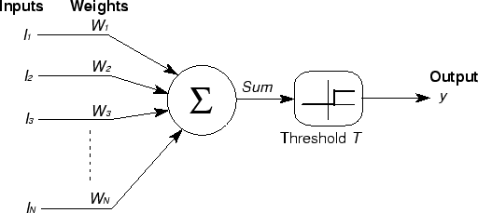

Computing Elements

Slide 20
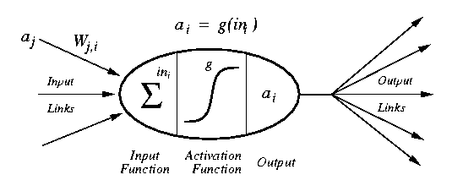
A Computing Unit.
Now in more detail but for a particular model (sigmoid)

Slide 21
Activation Functions
The operation of an artificial neural network is to sum up the product of the associated weight and the input signal and produce an output or activation function. For the input unit this activation function is the identity function. The neuron of a particular layer gets the same type of activation function. In almost all cases non- linear activation functions are used
The various types of activation functions used in a neural network are
identity function,
binary step function,
binary sigmoid functions and
bipolar sigmoid functions.

Slide 22
Identity functions
This function is denoted by f(x) = x for all x
Single layer neural networks make use of a step function while converting a continuously varying input function to a binary output (0 or 1) or a bipolar output (1 or -1).

Slide 23
Binary step function
This function makes use of a threshold.
A binary step function with a threshold T is given by
f(x) = 1 if x >= T
f(x) = 0 if x < T

Slide 24
Sigmoid functions
Sometimes S shaped functions called sigmoid functions are used as activation functions which are found useful.
Logistic and hyperbolic tangent functions are commonly used sigmoid functions.
The sigmoid functions are extensively used in back propagation neural networks because it reduces the burden of complication involved during training phase.
Binary sigmoid:
The logistic function, which is a sigmoid function between 0 and 1 are used in neural network as activation function where the output values are either binary or varies from 0 to 1. It is also called as binary sigmoid or logistic sigmoid.
Bipolar Sigmoid:
A logistic sigmoid function can be scaled to have any range of values which may be appropriate for a problem. The most common range is from -1 to 1. This id called bipolar sigmoid.

Slide 25
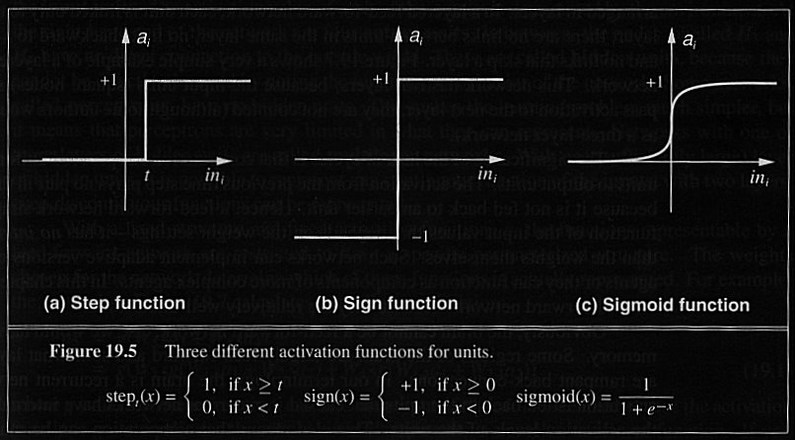
Activation Functions

Slide 26
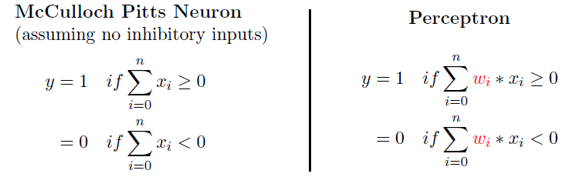
Perceptron vs McCulloch-Pitts Neuron

Slide 27
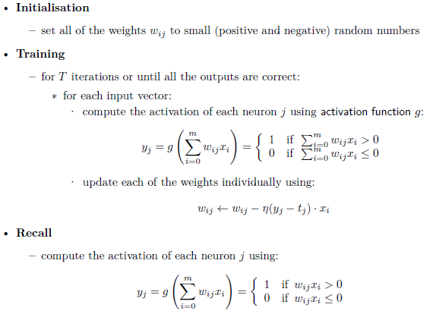
The Perceptron Algorithm

Slide 28
Computing the computational complexity of this algorithm is very easy
The recall phase loops over the neurons, and within that loops over the inputs, so its complexity is O(mn).
The training part does this same thing, but does it for T iterations, so costs O(Tmn).

Slide 29
Learning algorithm
While epoch produces an error
Present network with next inputs from epoch
Error = T – O
If Error <> 0 then
W_{j} = W_{j} + LR * I_{j} * Error
End If
End While

Slide 30
Learning algorithm
Epoch : Presentation of the entire training set to the neural network. In the case of the AND function an epoch consists of four sets of inputs being presented to the network (i.e. [0,0], [0,1], [1,0], [1,1])
Error: The error value is the amount by which the value output by the network differs from the target value. For example, if we required the network to output 0 and it output a 1, then Error = -1

Slide 31
Learning algorithm
Target Value, T : When we are training a network we not only present it with the input but also with a value that we require the network to produce. For example, if we present the network with [1,1] for the AND function the target value will be 1
Output , O : The output value from the neuron
Ij : Inputs being presented to the neuron
Wj : Weight from input neuron (I_{j}) to the output neuron
LR : The learning rate. This dictates how quickly the network converges. It is set by a matter of experimentation. It is typically 0.1

Slide 32
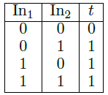
Training Perceptron – OR gate
initialize the weights to small random numbers, so we’ll pick w0 = −0.05,w1 = −0.02,w2 = 0.02.
Now we feed in the first input, where both inputs are 0: (0, 0).
Remember that the input to the bias weight is always −1, so the value that reaches the neuron is −0.05 × −1 +−0.02 × 0 + 0.02 × 0 = 0.05
This value is above 0, so the neuron fires and the output is 1, which is incorrect according to the target

Slide 33
Contd..
update rule: wij wij −η (yj − tj) · xi
w0 : −0.05 − 0.25 × (1 − 0) × −1 = 0.2
w1 : −0.02 − 0.25 × (1 − 0) × 0 = −0.02
w2 : 0.02 − 0.25 × (1 − 0) × 0 = 0.02
Now feed in the next input (0, 1) and compute the output
w0 : 0.2 − 0.25 × (0 − 1) × −1 = −0.05
w1 : −0.02 − 0.25 × (0 − 1) × 0 = −0.02
w2 : 0.02 − 0.25 × (0 − 1) × 1 = 0.27
For the (1, 0) input the answer is already correct so we don’t have to update the weights at all, and the same is true for the (1, 1) input.
So now we’ve been through all of the inputs once.
Unfortunately, that doesn’t mean we’ve finished—not all the answers are correct yet.
We now need to start going through the inputs again, until the weights settle down and stop changing, which is what tells us that the algorithm has finished.

Slide 34
Training Perceptrons
For AND
A B Output
0 0 0
0 1 0
1 0 0
1 1 1
-1
W₁ = ?
x
t = 0.0
W₂ = ?
W₃ = ?
y
What are the weight values?
Initialize with random weight values

Slide 35
Training Perceptrons
For AND
A B Output
0 0 0
0 1 0
1 0 0
1 1 1
-1
W₁ = 0.3
x
t = 0.0
W₂ = 0.5
W₃ =-0.4
y

Slide 36
Learning in Neural Networks
Learn values of weights from I/O pairs
Start with random weights
Load training example’s input
Observe computed input
Modify weights to reduce difference
Iterate over all training examples
Terminate when weights stop changing OR when error is very small

Slide 37
Decision boundaries
In simple cases, divide feature space by drawing a hyperplane across it.
Known as a decision boundary.
Discriminant function: returns different values on opposite sides. (straight line)
Problems which can be thus classified are linearly separable.

Slide 38
Decision Surface of a Perceptron
x₂
x₂
+
+
+
-
+
-
-
x₁
x₁
+
-
-
+
-
Linearly separable
Non-Linearly separable
Perceptron is able to represent some useful functions
AND(x₁,x₂) choose weights w₀=-1.5, w₁=1, w₂=1
But functions that are not linearly separable (e.g. XOR)
are not representable

Slide 39
Linear Separability
X₁
A
A
A
Decision
Boundary
B
A
A
B
B
B
A
B
A
B
B
X₂
B

Slide 40
Different Non-Linearly Separable Problems
Types of
Decision Regions
Exclusive-OR
Problem
Classes with
Meshed regions
Most General
Region Shapes
Structure
Single-Layer
Half Plane
Bounded By
Hyperplane
A
B
B
A
B
A
Two-Layer
Convex Open
Or
Closed Regions
A
B
B
A
B
A
Three-Layer
Arbitrary
(Complexity
Limited by No.
of Nodes)
A
B
B
A
B
A

